Slide 1
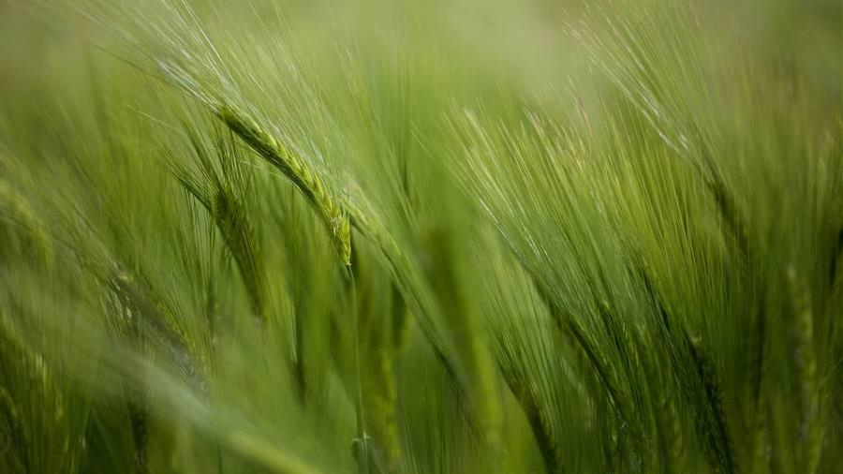
New South wales grazing study
Mel Beall
Nashville Software School - Data Analytics Cohort 9

Slide 2
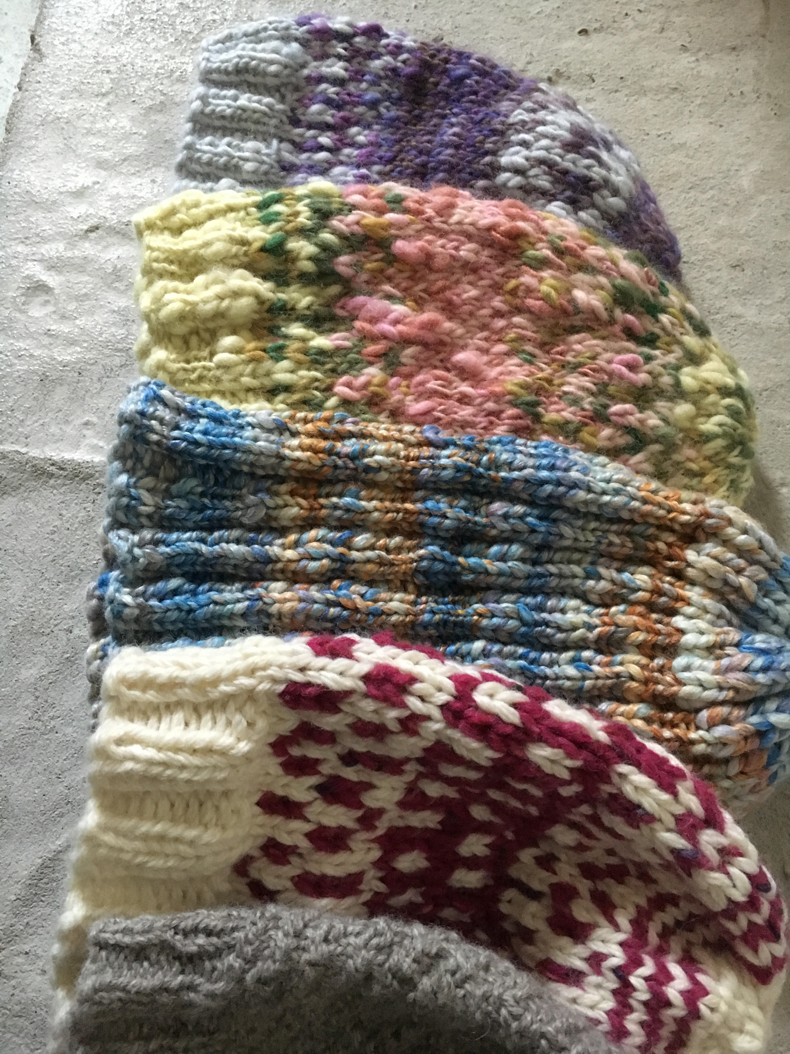
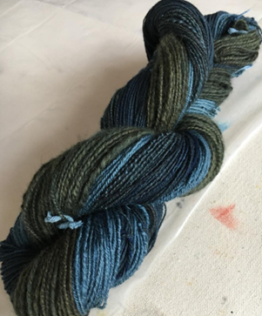
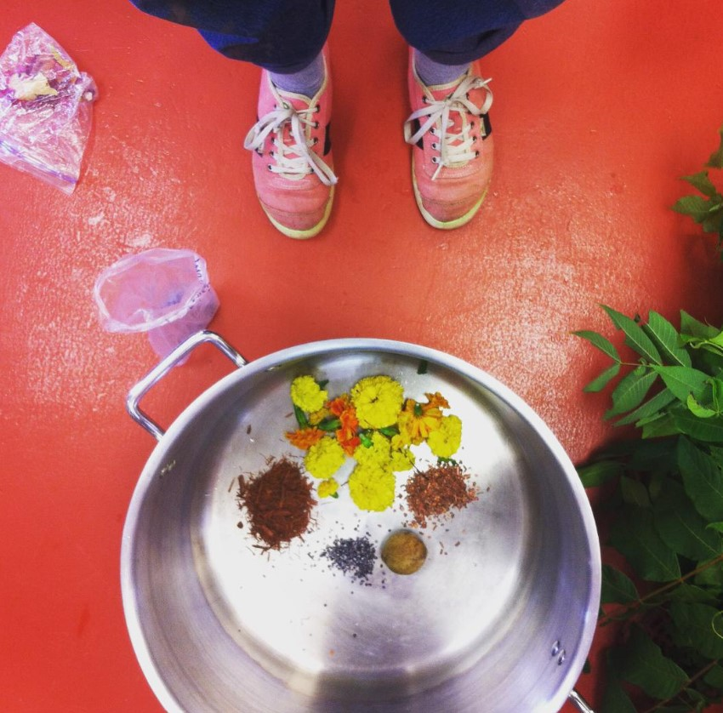
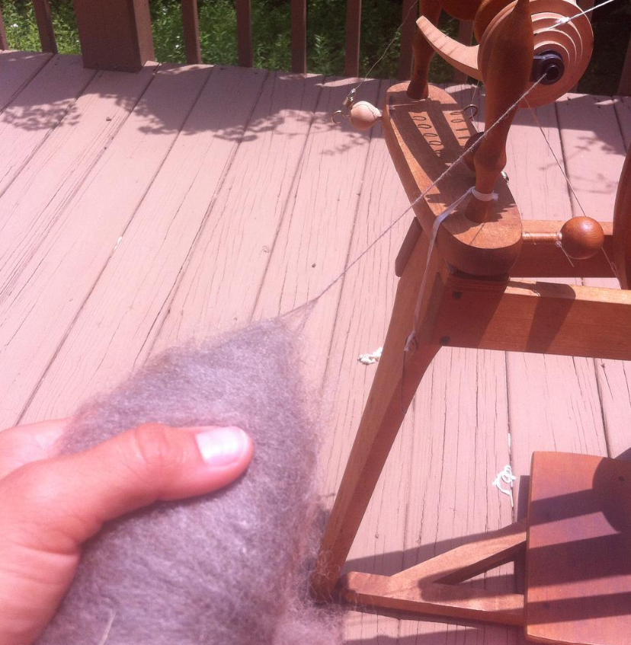


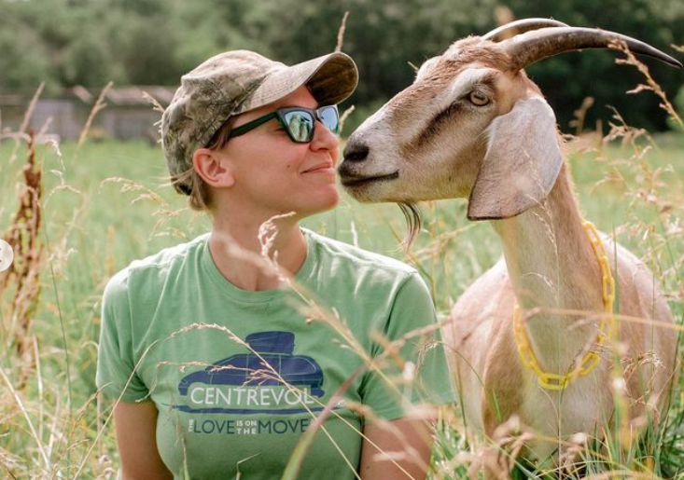
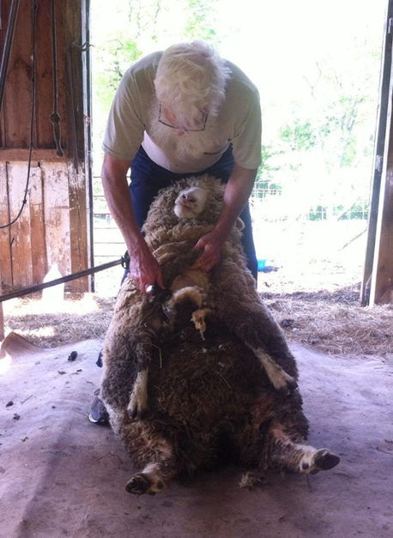
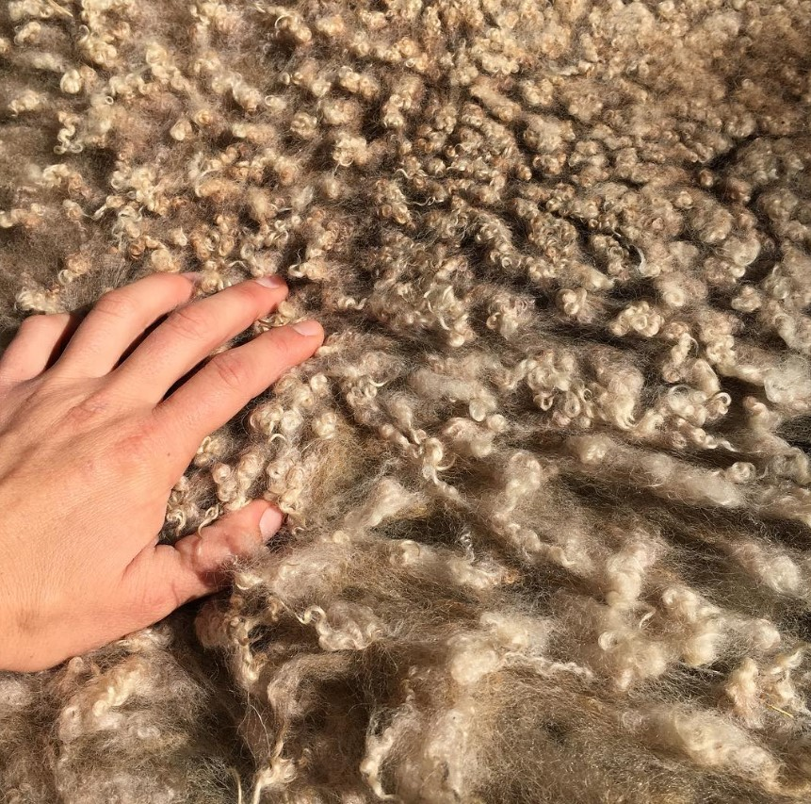
Motivation
Stress Relief
Yarn obsession
KNIT LIKE GRANDMA
HOW IT’S MADE
THE SOIL CYCLE
wool
RAW MATERIAL
grazing
ANIMAL HEALTH
SOIL IMPROVEMENT
CYCLE COMPLETION

Slide 3
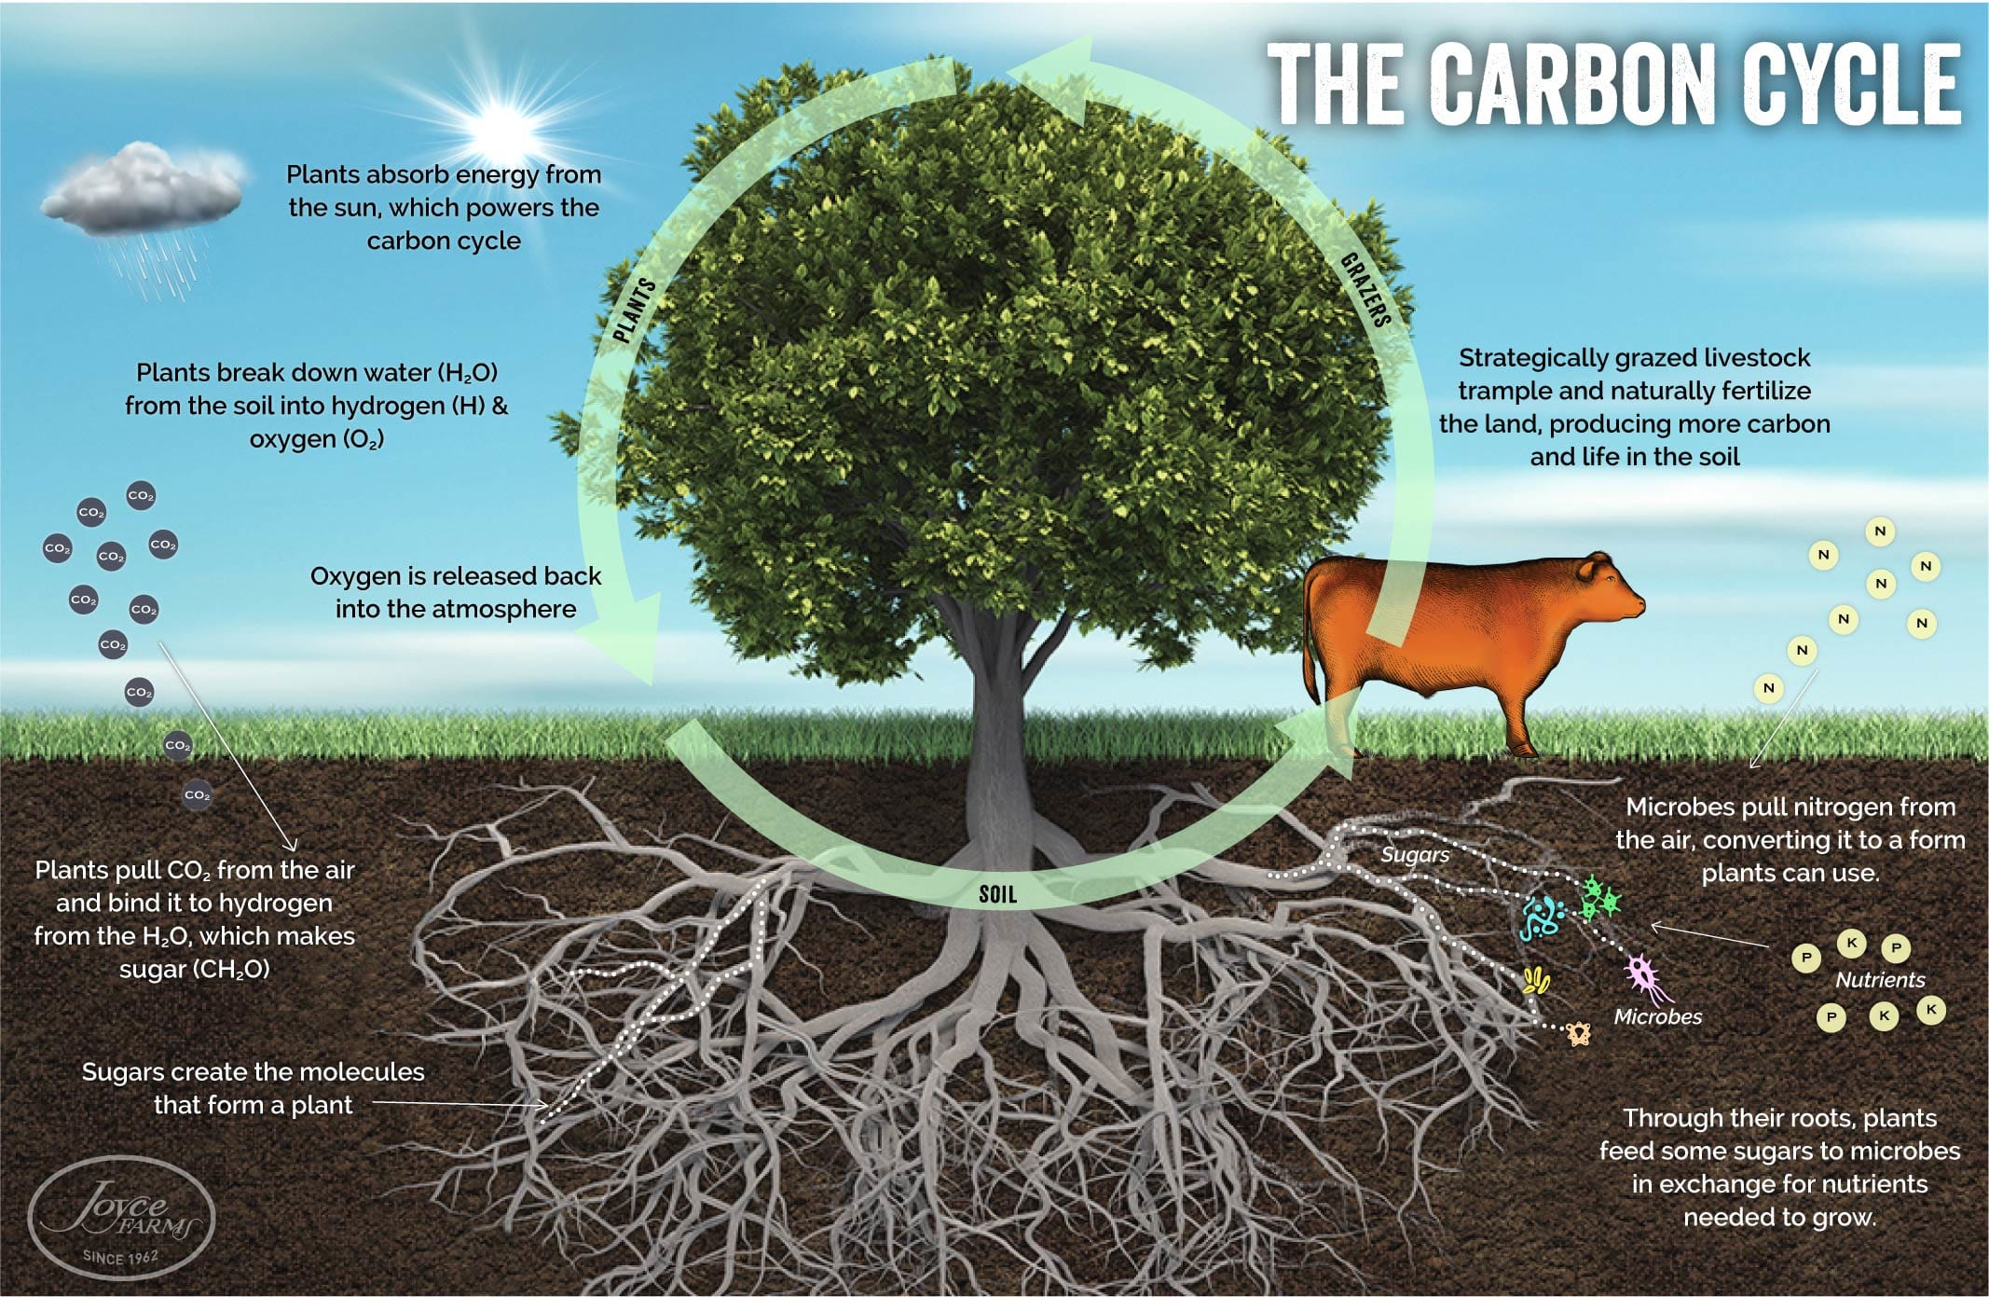
The carbon Cycle
“The final piece of the carbon cycle is grazing.
[…]
A ruminant is a solar-powered grass harvesting and processing miracle. Cattle that move across the land (using rotational grazing, eating no more than half the grass) leave partially digested biomass (i.e. manure and nitrogen-rich urine) spread evenly in their wake. What gets left behind is everything the grass needed to grow in the first place—a sort of customized fertilizer. Their trampling also provides an armor of plant life for the soil and feeds the soil microbes, producing new carbon and stimulating new soil life.”
Image courtesy of Dr. Allen Williams, Ph.D.
The Circle of Life: How the Carbon Cycle Powers our Ecosystem — Northeast Recycling Council (nerc.org)

Slide 4
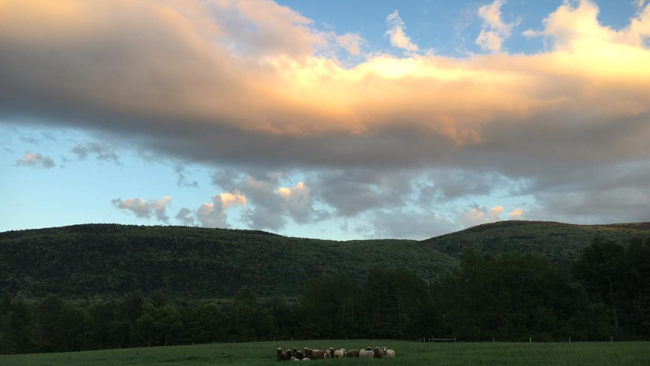

project overview
NEW SOUTH WALES GRAZING STUDY
FOUR DATASETS
THREE COMMUNITIES
54 SITES
THREE YEARS

Slide 5
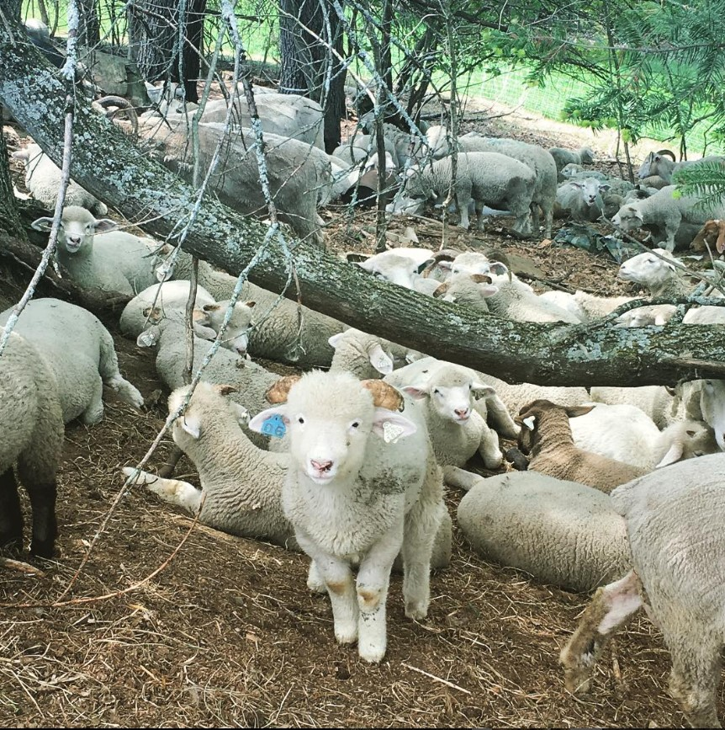
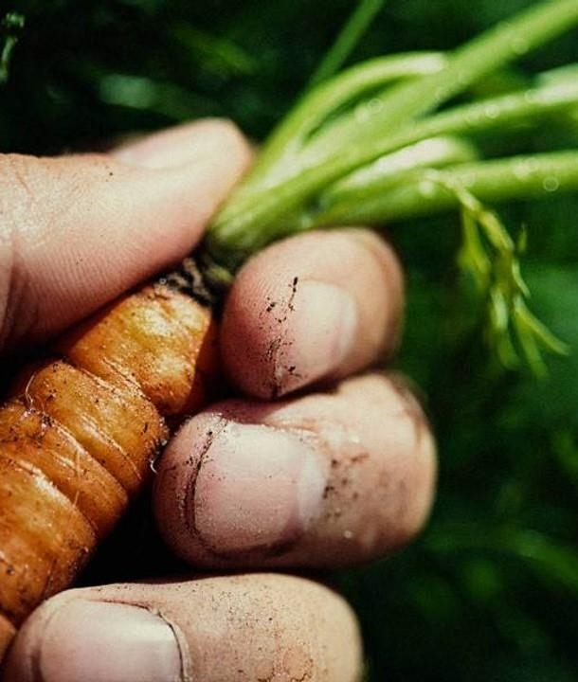
project overview
1​
Identify the primary indicators correlated to soil health
Chemical
Physical
2
Evaluate cover story
Grasses/Shrubs
Invasives/Natives
3
Evaluate which animals have the largest impact on soil health
Carbon deposits in dung
Soil disturbance

Slide 6
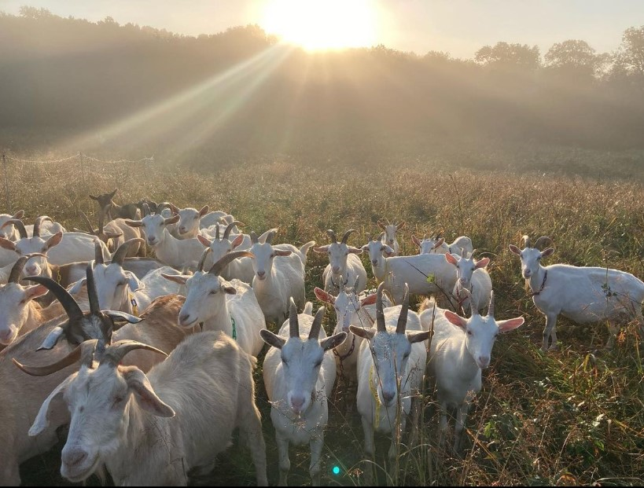
project limitations
Definitions of scientific terms

Slide 7
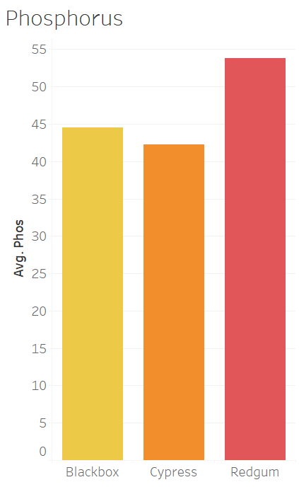
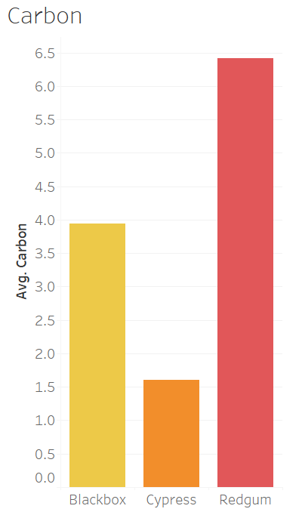
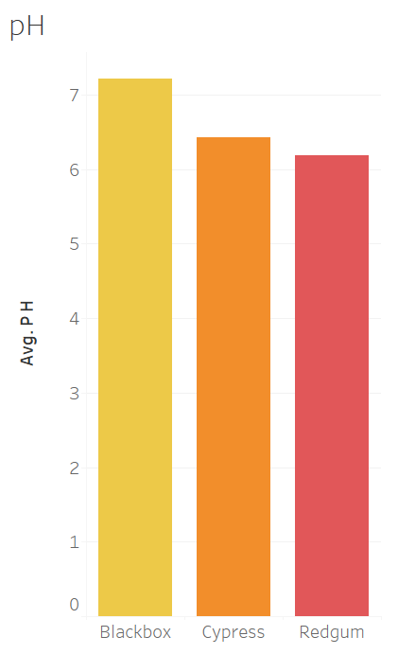
Soil health
IDEAL PHOSPHORUS
15–20 mg/kg for dryland pastures
25–30 mg/kg for irrigated and improved pastures
30–50 mg/kg for tree crops
50+ mg/kg for vegetables

Slide 8
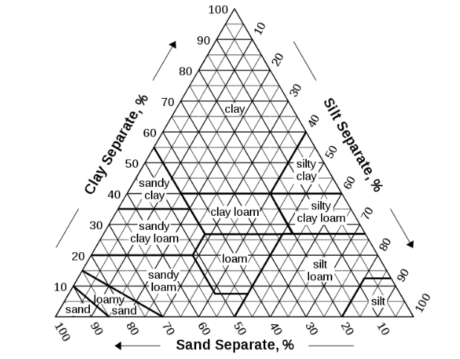
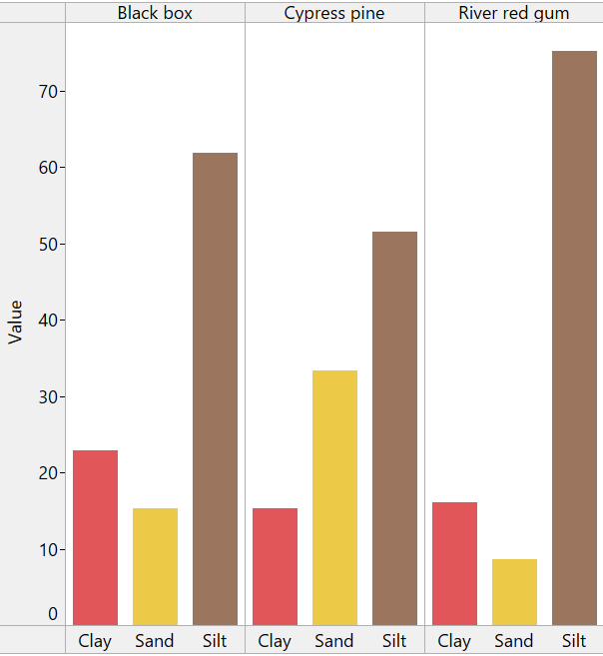
TEXTURE ANALYSIS
Image Courtesy of USDA Soil Survey Division Staff

Slide 9
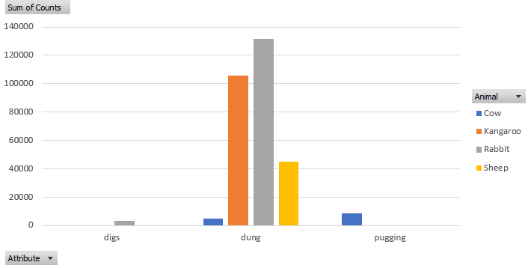
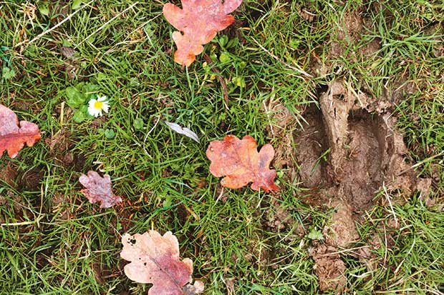
PUGGING
Compaction of soil due to herd ambulation
Impacts moisture content, infiltration, and aeration

Slide 10
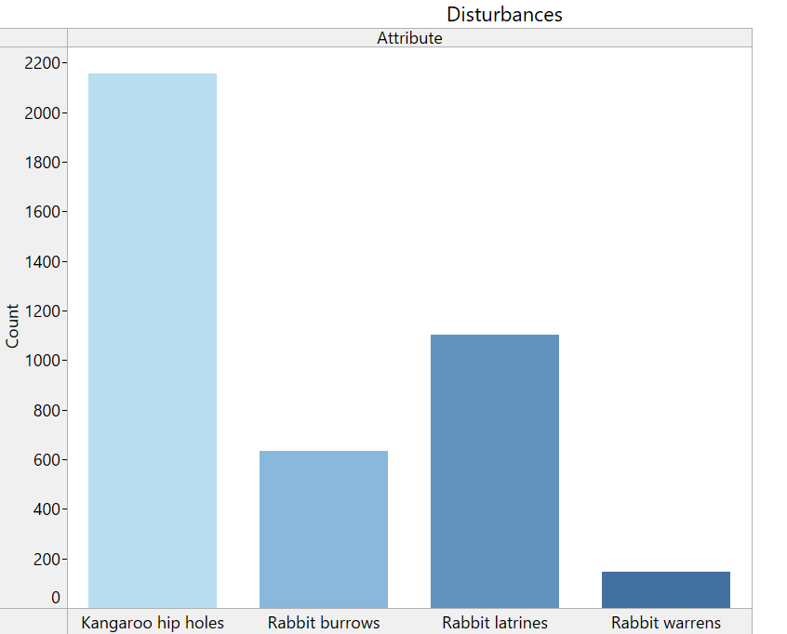
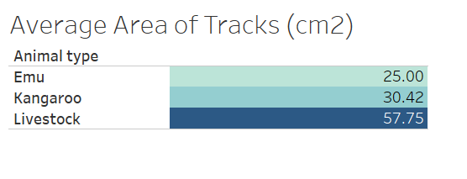
Animal impact

Slide 11
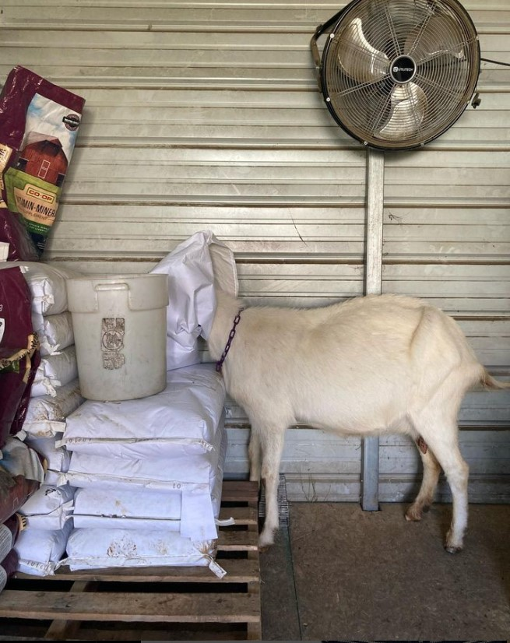
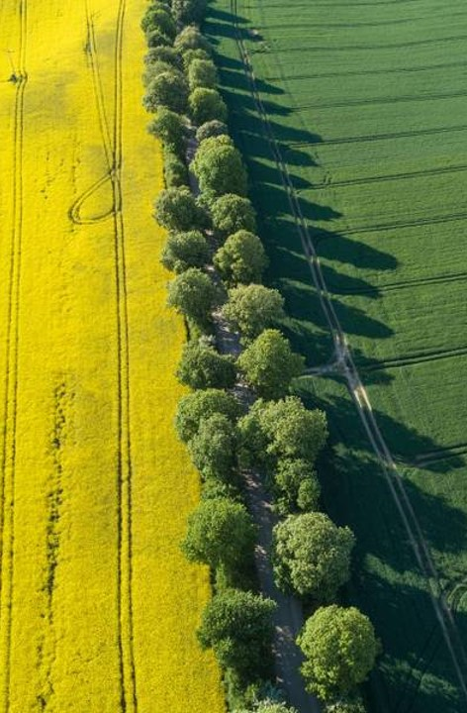
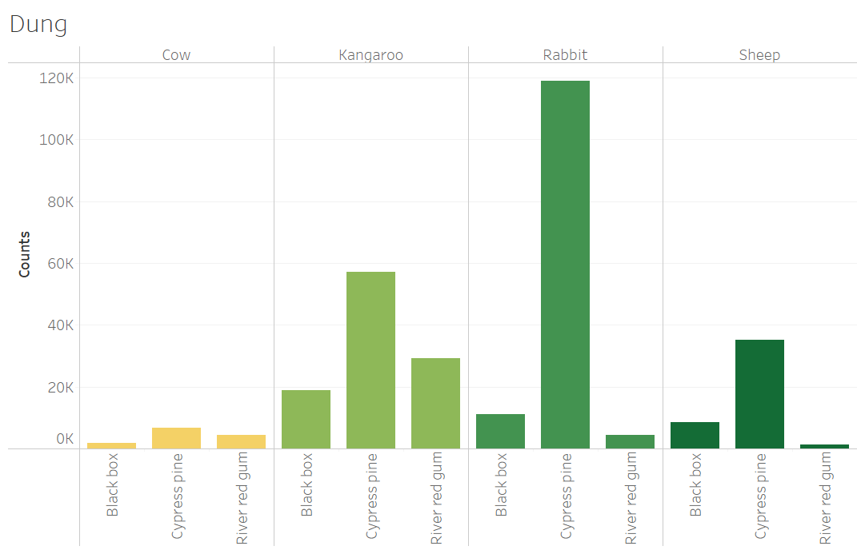
Grazing intensity
Large (5m x 5m)
Cattle
Sheep/goat
Kangaroo
Small (0.5m x 0.5m)
Kangaroo
Rabbit
Sheep/goat

Slide 12
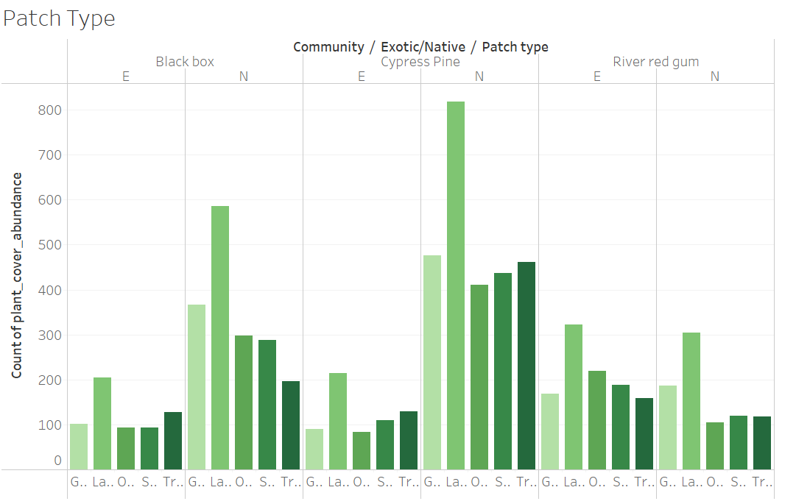
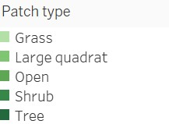
Cover story

Slide 13
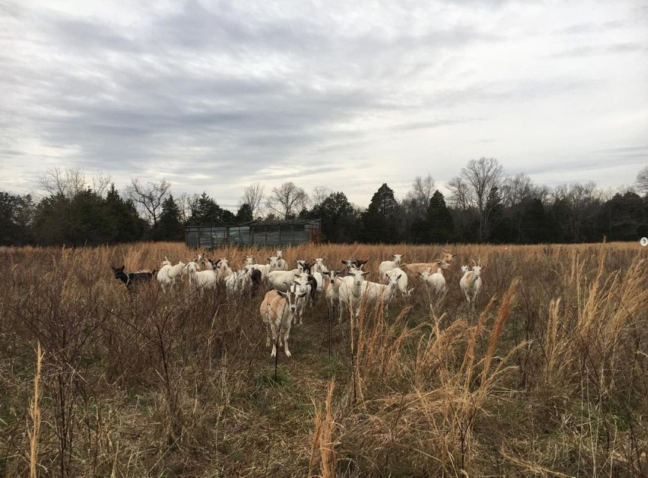
summary
While soil health is likely impacted by the kind of animal, the amount of droppings dispersed throughout, and the forage available, deeper analysis is required at this time to determine:
Seasonality of forage
Tracking of grazing place over time
Correlation of soil condition to soil chemistry
How many livestock are grazing?

Slide 14
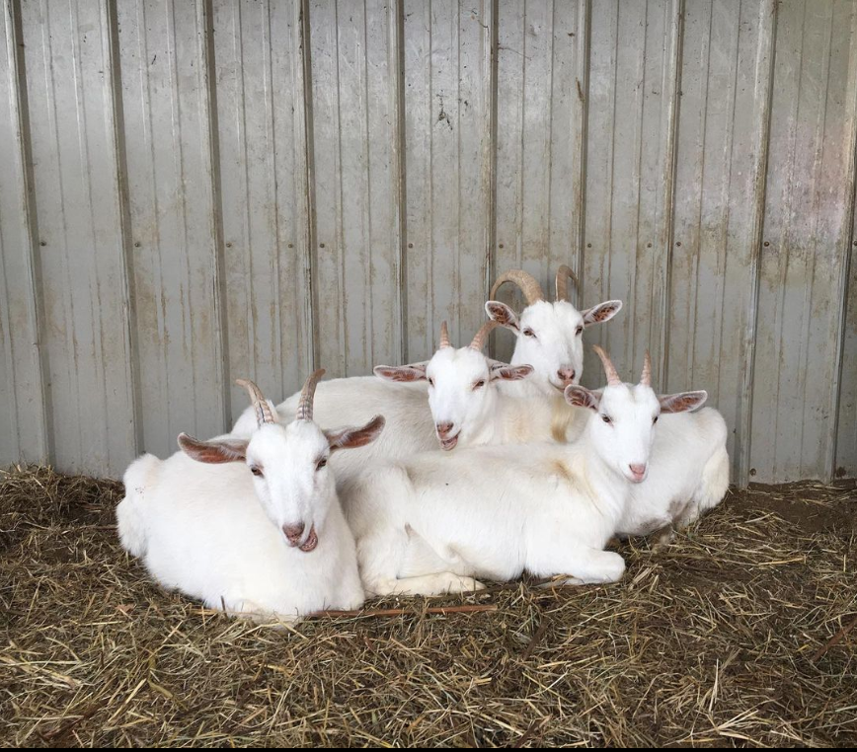
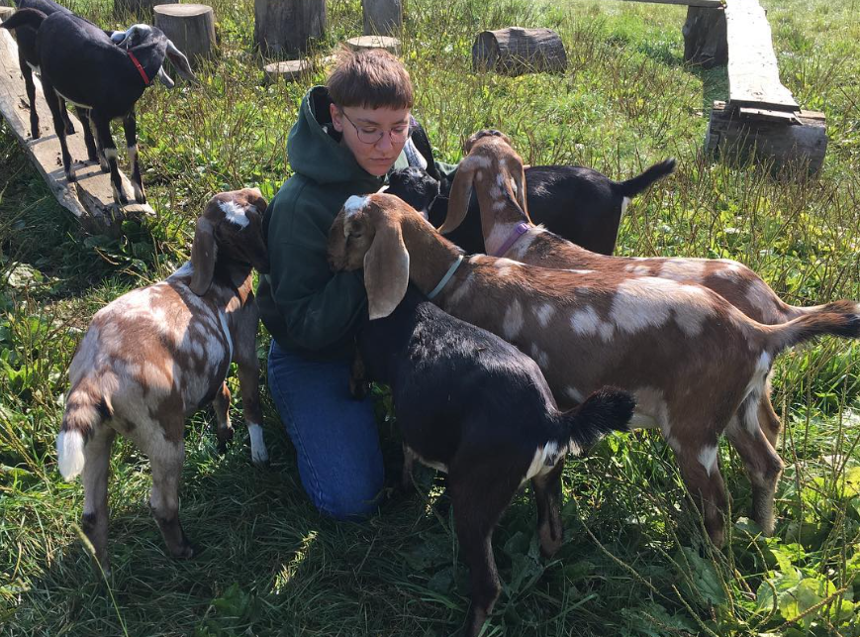
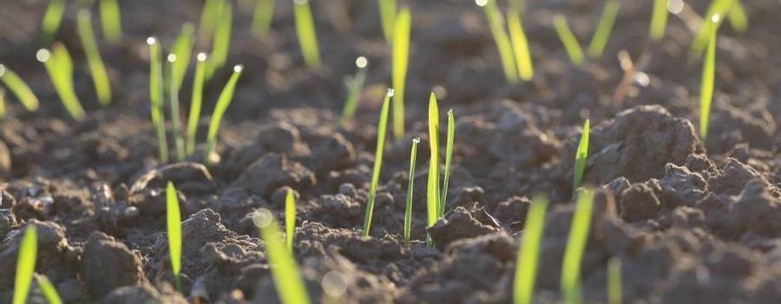
RECOMMENDATIONS
GOAT PILE
GET ABSOLUTELY BURIED BY A PILE OF BABY GOATS OR SHEEP IF POSSIBLE
Intensive grazing
Targeted Grazing
Calculation of animal per acre
Seasonally available forage
Optimized growth time
Minimal soil disturbance
Maximum dung dispersal

Slide 15
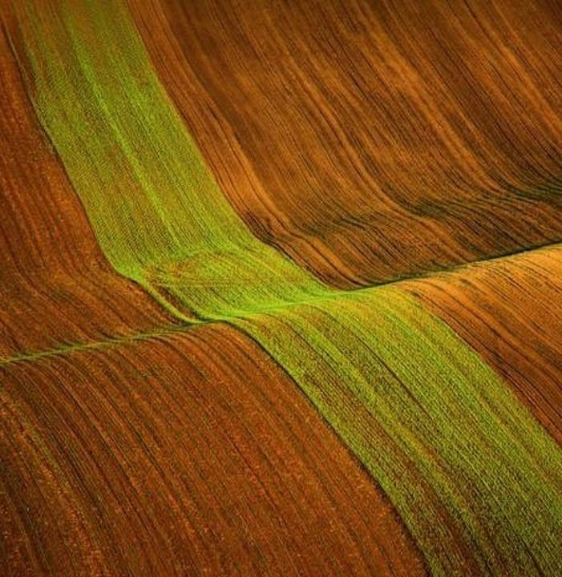
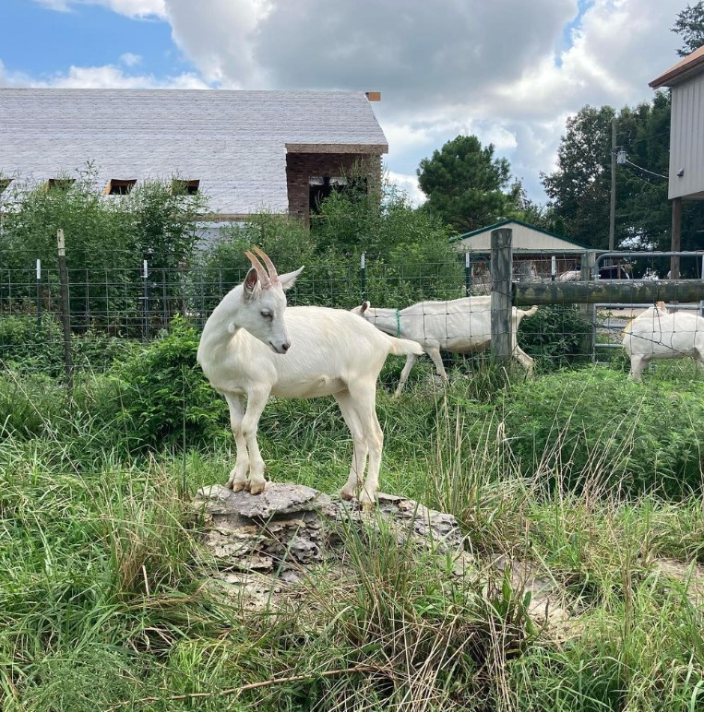
Thank you
Mel Beall​​
Nashville Software School​
Data Analysis Cohort 9

